Slide 1
Limestone Charter Association
Goals and Objectives, and Evaluating Pupil Performance

Slide 2
Steps to Find SC Report Card
Step One www.ed.sc.gov or www.screportcards.ed.sc.gov and jump to Step Two
Put curser over Data Tab and Click Report Cards
Click SC Report Cards
Click SC Report Cards (external link)
Step Two
Choose either view report card or compare
If you are looking for a list of all schools choose advanced data then click download data, pick a year and then choose report cards data for researchers

Slide 4
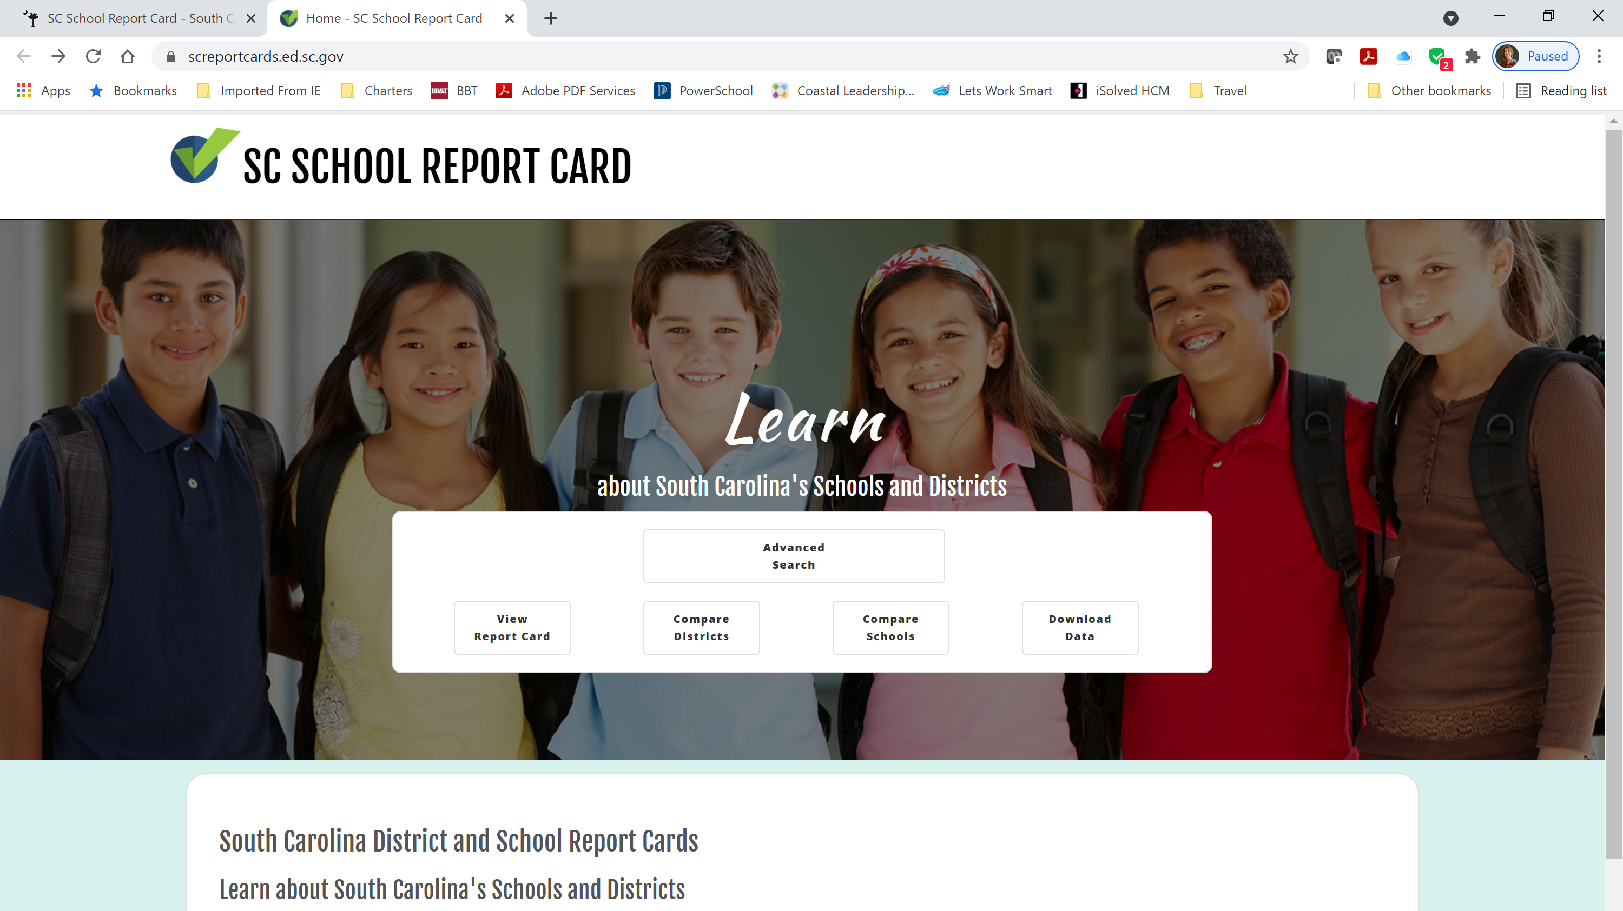

Slide 5
Goals are outputs
Goals are not what the teachers are doing,
they are what students achieve.

Slide 6
What is the Purpose of your School
Before you write any goals, you must understand the population you expect to serve.
Once you understand the population then decide on the educational plan. What is the purpose of your school.
Your goals should demonstrate your purpose by stating the academic, behavioral and/or extra curricular achievements.
Will the reader of your narrative on the SC Report Card be able to see the correlation between your student data and the purpose of your school?

Slide 7
Considerations for Goal Setting
How are students performing at nearby schools?
How are students performing statewide?
How will your expected student population differ from nearby schools/statewide?
What are you trying to achieve EVENTUALLY?
Exceed state average?
Top 5, 10, 20% of schools in the state?

Slide 8
First Year Goals vs. Tenth
The first year’s goals should be benchmarks that will start the process of comparison for the next nine years.
Starting from Year Two, the charter must have goals for each year. The goals can be building or based on the purpose jump from Year to Year.
The charter must contain academic achievement either through testing percentages or through growth based on individual students over multiple years.
*Growth is much easier to measure in elementary school than in high school.

Slide 9
Performance Frameworks
All Sponsors have a framework that has a two-fold purpose.
1) to judge the school’s academic and operational performance from year to year and
2) to help the school develop academic and mission driven goals for future years.

Slide 10
State Testing Isn’t Everything
Mission Driven Goals are ESSENTIAL to the charter.
Examples:
Language Immersion-how will you measure fluency?
STEM or STEAM- how will you show a higher understanding of STEM subjects?
Project Based-how will you measure the effectiveness of the project on content knowledge?
Leadership-what instrument will you use to measure leadership?
Dual Enrollment-how many more credits will students leave high school with over the traditional school setting?
Fine Arts- how will you access the students’ portfolios to show competence in a selected art?

Slide 11
Comparing Target Groups for Goals
If the charter is focused on a target population, then there must be at least one goal comparing the students’ academic achievement to the targeted population attending the traditional schools.

Slide 12
Using Goals to Determine achievement
If you are applying to Limestone, please write your goals as inclusive and not dependent upon the objectives to determine achievement of the goal.
When annually reviewing your charter goals, the sponsor must decide if each goal has been achieved based on the actual goal. It becomes less clear when a school writes the goals as an overarching idea and measures it by achieving objectives.
If a goal has four objectives and the school achieved three out of four objectives, did the school achieve the goal?

Slide 13
SMART GOals
Specific
Measureable
Achieveable
Realistic
Timely

Slide 14
Choosing The Evaluation Tools
Formative Assessments
Don’t tie yourself to a specific Brand Name!!!!!!!, unless it is specific to your mission goal.
Explain what the tool measures, for example MAP vs. IREADY.
Check the SCDE website for approved formative assessments
https://ed.sc.gov/tests/middle/adoption-list-of-state-approved-formative-interim-assessments/

Slide 15
Not hitting the target
What happens if you don’t meet your assessment goals?
In the narrative you must explain how the school will enact remedial programs when students are not hitting the assessment targets set for them.
Did you set the targets too high or are you just not hitting the mark?
Does the educational program need to be reevaluated?
Are you doing enough professional development to ensure the instruction fits the model?

Slide 16
Professional development
If you choose a specific educational model it most likely will have professional development program to accompany it. Are you purchasing that section if it is extra? Describe it, or if you aren’t how will the faculty learn the program?
Describe your plan for professional development if you are not using a specific in the box educational program.

Slide 17
Program Vs. Budget
The budget should clearly show any cost associated with buying curriculum and professional development.
These cost should be discussed under professional development and under the budget section.
If you are not paying for a curriculum and will handle the professional development on your own, describe the credentials required to give that service and any related cost .

Slide 18
Questions?

