Slide 1


Finances and Facilities
LIMESTONE CHARTER ASSOCIATION

Slide 2
Define Budget
An estimation of the revenue and expenditures over a specified future period of time. (5 year detailed and 10 year overview)

Slide 3
Suggestion!!!!!
Find and expert to help you do your budget. Expert meaning someone who deals with school budgets on a daily basis.

Slide 4
Items in a Budget
Projected enrollment
Projected revenue
Projected expenditures
Realistic assumptions and the basis for these assumptions
Cash flow projections

Slide 5
Projected Enrollment and Revenue
When projecting enrollment, some items that you may want to consider are:
  School location
  School capacity
At a minimum, a new charter school will receive funding in the following categories:
  Education Finance Act (FY 22 $2,516)
  South Carolina Public Charter School Act (FY 22 $3,600 – brick and mortar, $1,900 – virtual)
  Fringe Benefits (45-day)
Include documentation for items such as grant money or donations received or likely to receive

Slide 6
Weightings vs. Add-Ons
Weightings
Add-Ons
Program Code | Classification | Weighting
K | Kindergarten | 1.00
P | Primary | 1.00
EL | Elementary | 1.00
HS | High School | 1.00
SP | Speech Handicapped | 1.90
LD | Learning Disabilities | 1.74
VOC | Vocational (Grades 9-12) | 1.29
Program Code | Classification | Add-On
PP | Pupil In Poverty | .20
HA | High Achieving | .15
DE | Dual Enrollment | .15
AA | Academic Assistance | .15
LEP | Limited English Proficiency | .20

Slide 7
Projected Expenditures
Some items that need to be considered are:
School/student needs (such as curriculum, programs, technology, special education, supplies, insurance, etc.)
Personnel needs (such as professional development, staffing, salaries, benefits, supplies, etc.)
Board needs (such as training, legal fees, supplies, etc.)
Operational and maintenance needs (such as repairs & maintenance, facilities, custodial, phones, utilities, transportation, supplies, etc.)
Include Memorandums of Agreement for Negotiated Services

Slide 8
Realistic Assumptions and the Basis for these Assumptions
Explain Your Projections
You May Include Federal And Planning Dollars So Long As They Are Reasonable And Correlate To Your Population Projections.

Slide 9
Cash Flow Projections
Estimation of the timing and amounts of cash inflows and outflows over a specific period of time.
Inflows = revenue
Outflows = expenditures

Slide 10
Manuals/Handbooks
Financial Accounting Handbook
http://ed.sc.gov/agency/as/ManualsHandbooksandGuidelines.cfm
Funding Manual
http://ed.sc.gov/agency/cfo/finance/Financial-Services/ManualsandGuidelines.cfm

Slide 11
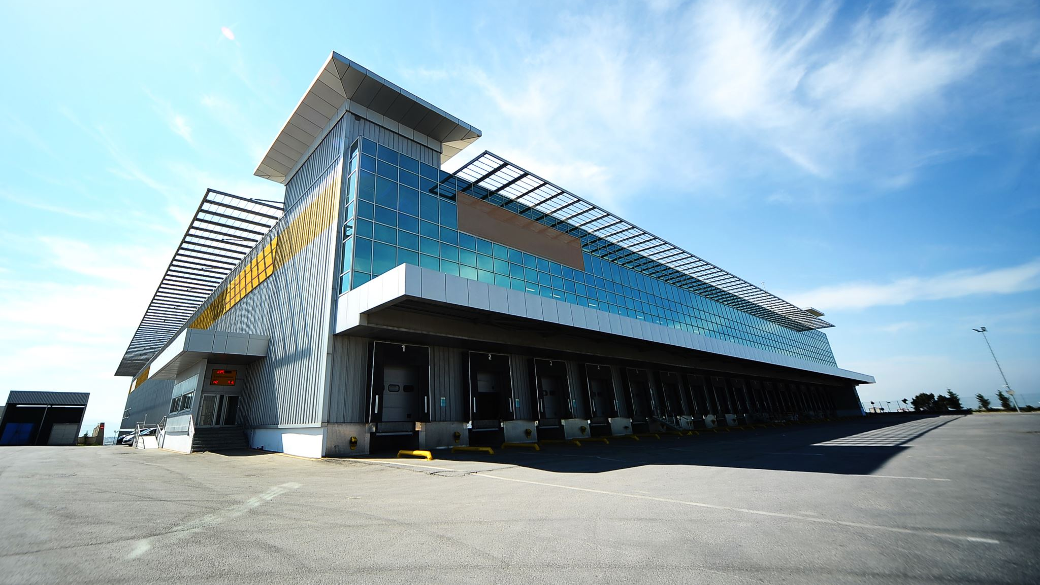
Facilities
Finding your Dream Home
(or at least what you can afford)

Slide 12
A facility is not required when Submitting the Application
What is Required:
  A general Idea of where the area you wish to be located and you understand the demographics of the area
  Evidence that you have searched the area for possible buildings or land
  Evidence you have research facility financing
  Evidence that as soon as you are approved you will be ready to move forward with securing a facility

Slide 13
Options for facility financing
Lease with facility owner with upfits to meet improvement included
Lease with facility owner with upfits being funded from outside group
Developer funding
This may be a lease/buy-out or a bond deal
Bond Deal

Slide 14

People involved in facilities
Planning Committee
Commercial realtor
Design professional
  This may be an architect or an engineer
Contractor
Financing Agent
Third Party Inspector
OSF- Office of School Facilities

Slide 15

When Facilities Aren’t Ready
In a traditional district when a new facility isn’t ready by the beginning of the school year, children and sometimes teachers, stay at their current school. Not so in charter schools
  When a school isn’t ready to open in charter school world its chaos!
      Children have enrolled in a school that is not their traditional district. If the school does not open they will have to reenroll back into their home school in their traditional district.
      Teachers are out of a job!
      Nobody gets paid.

Slide 16
Better Late than Never
A School that starts late causes the entire state’s allocation system to be held up until it has had a 5th day count.
Nobody is happy when this happens!

Slide 17
Questions?

